Slide 1
Lecture 33 : NN Review

Slide 2
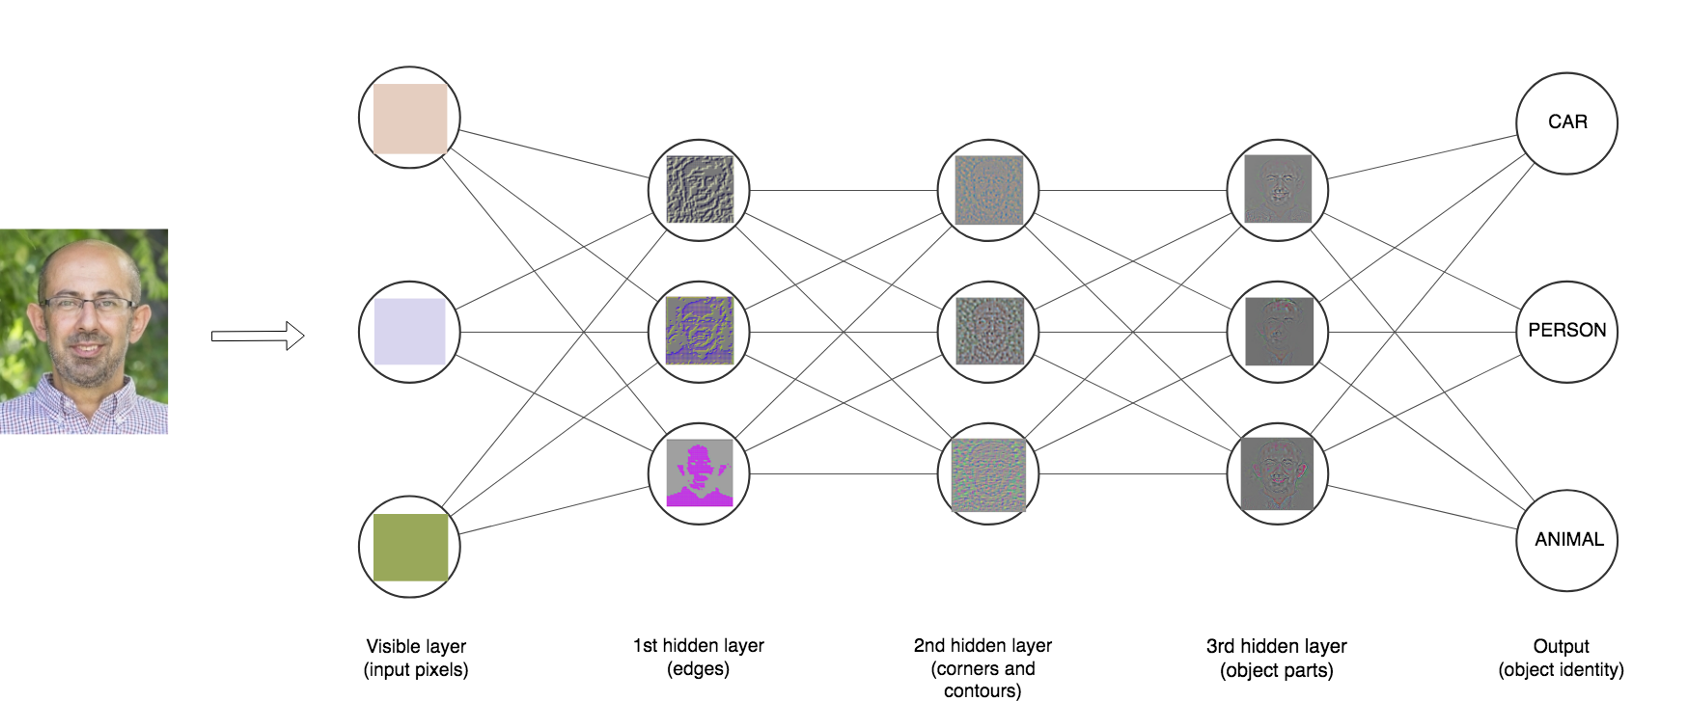
Review: neural networks
Deep learning is a mathematical framework for learning layered representations from data. Neural networks are models for learning such representations; they are structured in actual layers stacked next to each other.

Slide 3
When are neural networks useful?
Deep learning is not always the right tool for the job.
XGBoost, Random Forest or Gradient Boosting is usually a better choice for:
Tabular data, data with engineered features
NNs shine on:
Image recognition
Natural language processing
Autonomous driving
Speech recognition
Do NNs benefit from feature engineering? Yes, when there is domain knowledge, and/or when there is too few training data.

Slide 4
Ingredients for training a neural network
INPUT
The input data is a 2D data matrix of shape (batch_size, features).
All inputs to a NN need to be tensors. Values in the tensors should be small (in the [-1, 1] or [0, 1] range). Heterogeneous data should be normalized. Some feature engineering might benefot small datasets.
We pass the number of features as a parameter to the input layer. If our training data consists of 6000 observations, each with 4 features, then input_shape = (4,)

Slide 5
Ingredients for training a neural network
INPUT
Categorical variables should be encoded using one of the options we have learned:
Integer Encoding: each unique label is mapped to an integer;
One Hot Encoding: each label is mapped to a binary vector;
To input images in a FFN we must flatten them first, that is, reshape the 2D or 3D array of pixel values to a 1D array (these will be the features)

Slide 6
Ingredients for training a neural network
LOSS FUNCTION
Regression: Mean squared error (mean_squared_error)
Classification: Cross-entropy
For binary target variables we use binary_crossentropy.
For multiclass target variables, integer encoded, we use sparse_categorical_crossentropy.
For multiclass target variables, one-hot encoded, we use categorical_crossentropy.

Slide 7
Ingredients for training a neural network
OUTPUT
number of features = 4
model.add(tf.keras.layers.Dense(4, activation='softmax’))

Slide 8

Design choices for neural networks
MEME HERE

Slide 9
Design choices for neural networks
Unfortunately there is no magic formula

Slide 10

Optimization vs. Generalization
GET MORE DATA
REDUCE NETWORK CAPACITY
WEIGHT REGULARIZATION
OPTIMIZATION
Performing well on training data
GENERALIZATION
Performing well
on unseen data
DROPOUT

Slide 11
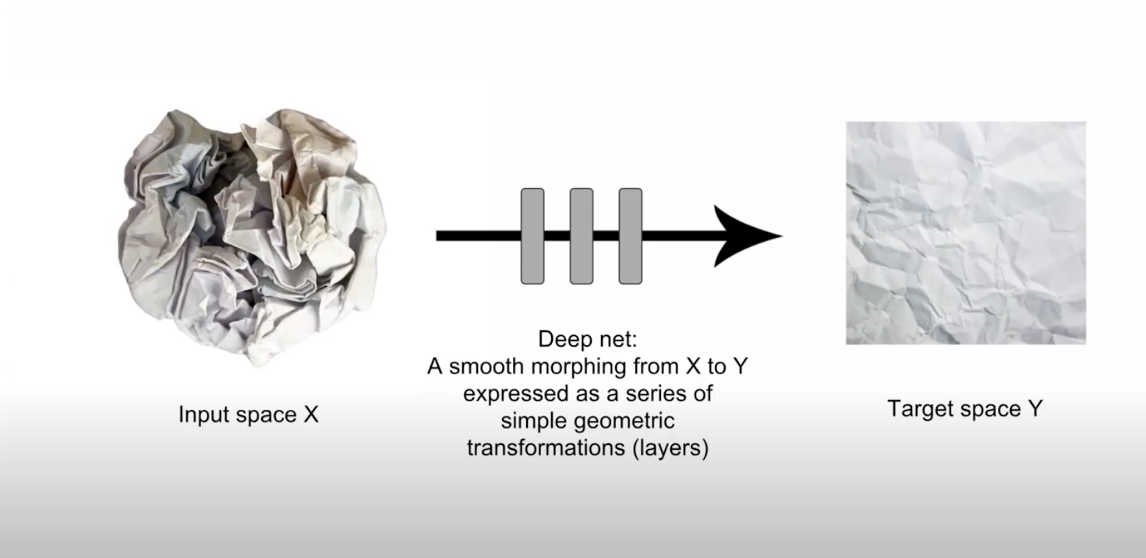
Regularization: Number of layers
We can think of layers as transformations from the input space of the layer to the output space of the layer; a transformation that involves an affine part followed by a non-linear part (activation function). A mapping to a lower dimensional space, as seen in the figure below, from a talk by Francois Chollet, the creator of keras.

Slide 12
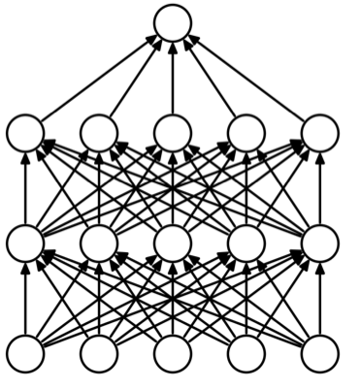
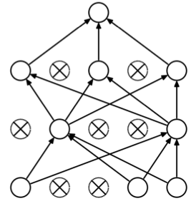
Regularization : Dropout
Dropout was developed by Geoff Hinton and his students at the University of Toronto. It consists of randomly dropping out (setting to zero) a number of output features of the layer during training. For balance during testing, the layer’s output values are scaled down by a factor equal to the dropout rate; no units are dropped out in test time.
In a large network many units can collaborate to respond to the input while the weights can remain relatively small.
This is called co-adaptation.
Dropout prevents overfitting by reducing co-adaptation of neurons. It’s like training many random sub-networks.

Slide 13
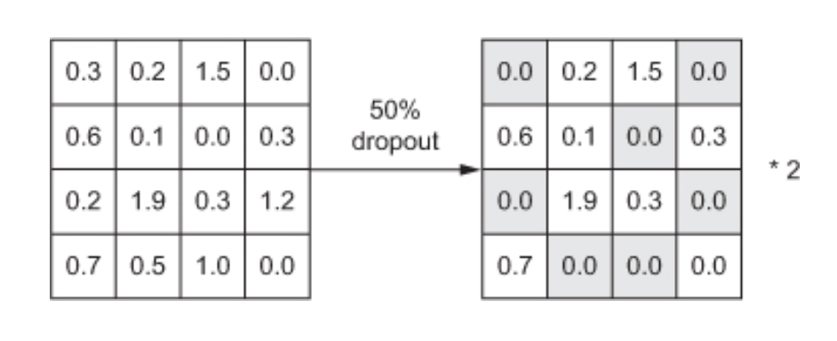
Regularization : Dropout
Its implementation in keras drops a percentage of the input nodes at training time, then scales the values up by the same proportion and does nothing at test time.
model.add(layers.Dropout(0.5))
Image: Francois Chollet

Slide 14
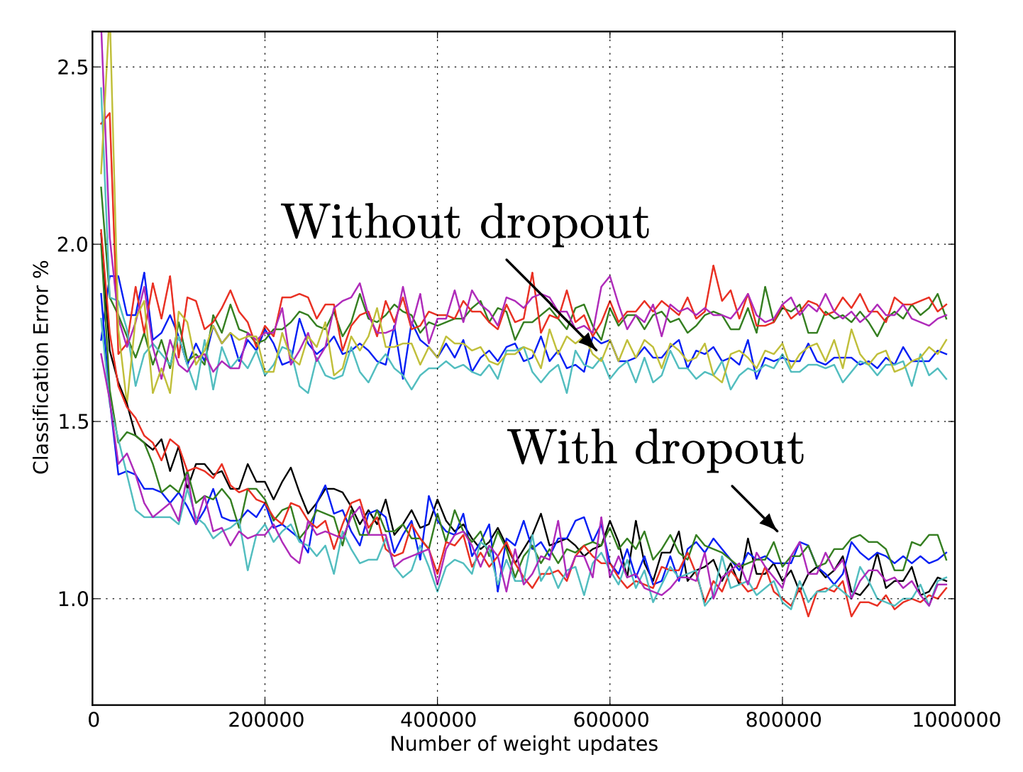
Regularization : Dropout
Widely used and highly effective
Test error for different architectures with and without dropout.
The networks have 2 to 4 hidden layers each with 1024 to 2048 units.

Slide 15
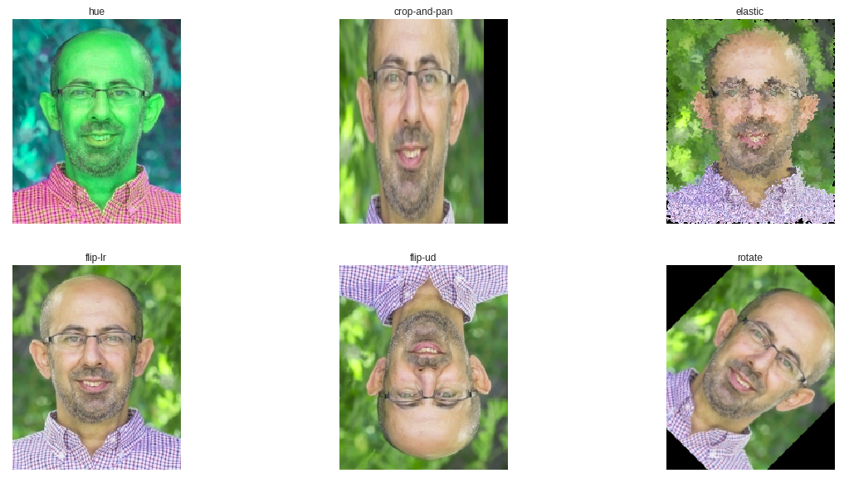

Regularization : Data augmentation

Slide 16
Regularization : Data augmentation dos and don'ts
Carefully choose your transformations. Not all transformations are valid.
Label 6
Label 6
Rotate by 180
Data Augmentation does not work for tabular data and not as nicely for time series.

Slide 17

Notebook

